Slide 1
Guidelines for Unit Tests
Giuseppe Scanniello
Simone Romano
Michelangelo Esposito

Slide 2
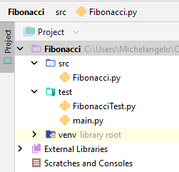
Separate test code from production one
Test classes and tested classes should be located in different source folders

Slide 3
A.A.A. pattern
You should be able to divide a test method into three subsequent sections:
Arrange---in this section, you should arrange all necessary preconditions and inputs
You can also setup methods to arrange all necessary preconditions and inputs
Act---in this section, you should exercise the unit to be tested
Assert---in this section, you should make sure that the expected results have been occurred

Slide 4
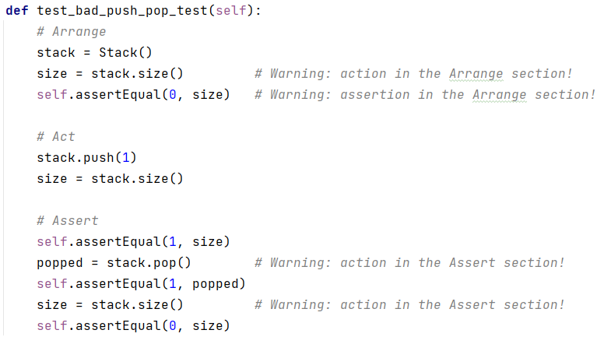
Why A.A.A. pattern?
Once you have identified the three sections, you can easily grasp if your test method smells bad

Slide 5
One assert per test
A unit test should contain just one assert
If it contains more than one assert, then split that test into two tests having one assert each
Why one assert per test?
If a test method has more than one assert, it is hard to tell which assertion has caused a test failure

Slide 6
Fast
Tests should run quickly
If they depend on expensive resources, replace those resources with test doubles
Why fast tests?
Developers need immediate feedback
If tests run slow, you will not run them frequently; if you do not run them frequently, you will not find problems early enough to fix them easily

Slide 7
Independent
Tests should not depend on each other
Why independent tests?
When tests depend on each other, then the first one can cause the other tests to fail so making diagnosis difficult

Slide 8
Repeatable
Tests should be repeatable in any environment
You can use test doubles to make tests repeatable
Why repeatable tests?
If your tests are not repeatable in any environment, then you will always have an excuse for why they fail
It is a matter of trust in your tests

Slide 9
Self-validating
The tests should have a Boolean outcome, namely either they pass or fail
Why self-validating tests?
You would like to have completely automated tests so that no manual work is needed to understand whether a test has passed or not

Slide 10


Further guidelines for unit tests

Slide 11

A test should be readable and meaningful
Self-documenting tests

Slide 12

A test should not be overprotective
Remove redundant assertions

Slide 13

Tests should be maintainable
Avoid duplication

Slide 14

Yes, tests should be maintainable
Do not use conditionals in your tests

Slide 15

Never failing tests do not make sense
Do not write tests without assertions

Slide 16

Tests should span the best of both worlds
Test happy paths - Test sad paths

Slide 17
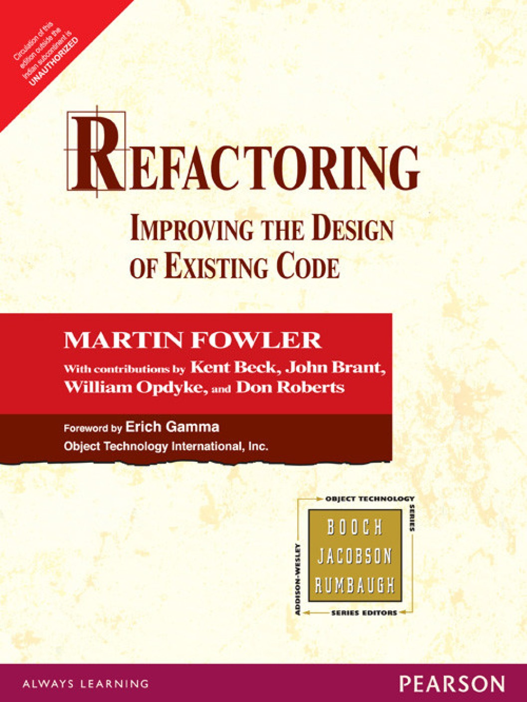
Refactor test code
Test code IS code

